Slide 1

Vel Tech Rangarajan Dr. Sagunthala R&D Institute of Science and Technology
School of Computing
Department of Computer Science and Engineering
10211CS224 / FULL STACK APPLICATION DEVELOPMENT (JAVA)
PROJECT REVIEW : MILESTONE PROJECT – 1
Design and develop a React JS based web application for Ticket Booking of an Internal Department Event (such as technical fest, or seminar)
Date: 17 - 04 - 2026
SDG: SDG No : 9 – Industry,Innovation,Infrastructure
Presented By:
V. Nanda Srinivas – VTU25911– Reg.No.23UECS0612
Courses Handling Faculty:
Dr. Hafizur Rahman- Assistant Professor

Slide 2
INTRODUCTION
1
Traditionally, ticket booking for such events is managed manually or using basic tools like spreadsheets or forms.
This approach can lead to issues such as data duplication, errors in ticket allocation, difficulty in tracking attendees, and inefficient management of event capacity.
To overcome these challenges, there is a need for an automated system that simplifies ticket booking and management.
This project focuses on designing and developing a React JS-based web application for ticket booking of internal department events.
The system allows users to register, log in, view available events, and book tickets easily.
The application uses modern web technologies to improve efficiency, reduce manual effort, and enhance user experience.
It has real-world relevance as event management systems are widely used in colleges, organizations, and conferences.
2
3
4
5
6
7
8
9

Slide 3
PROBLEM STATEMENT
Managing event ticket bookings manually or using simple tools can lead to several problems.
There may be errors in recording user details, overbooking of tickets, and difficulty in tracking the number of participants.
Existing systems may not provide real-time updates on ticket availability.
There is also a lack of proper user authentication and centralized data management in traditional methods.
Event organizers face challenges in managing attendee lists and ensuring smooth event execution.
Therefore, there is a need for a reliable and automated system that can efficiently handle ticket booking, user management, and event tracking.
1
2
3
4
5
6
7
8
9

Slide 4
OBJECTIVE(S)
1
To design and develop : A React JS-based web application that allows users to register, log in, view events, and book tickets for internal department events.
To implement and improve : Features such as real-time ticket availability, secure user authentication, and efficient event management to enhance user experience and system performance.
2
3
4
5
6
7
8
9

Slide 5
PROPOSED SYSTEM
1
The proposed system is a web-based ticket booking application developed using React JS for the frontend. It allows users to browse available events such as technical fests, seminars, or workshops and book tickets online.
The system provides functionalities like user registration, login, event listing, ticket selection, and booking confirmation. It maintains a centralized database to store user details, event information, and booking records.
The application ensures that ticket availability is updated in real time, preventing overbooking. It also provides an admin interface to manage events, monitor bookings, and generate reports.
Compared to traditional systems, this solution improves accuracy, efficiency, and user convenience. It is scalable and can be extended to support multiple events and advanced features like online payments.
2
3
4
5
6
7
8
9

Slide 6
PROPOSED SYSTEM ARCHITECTURE
Input :
User registration details (name, email, password)
Login credentials
Event selection
Number of tickets to bookProcessing .
Processing :
User authentication and validation
Fetching event details
Checking ticket availability
Processing booking request.
Database :
User information
Event details (name, date, capacity)
Booking records.
Output :
Successful registration/login message
Display of available events
Ticket booking confirmation
Admin reports and dashboards.
1
2
3
4
5
6
7
8
9

Slide 7
WORKFLOW
USER │ ▼ [1. Register / Login] │ ▼ [2. View Available Events] │ ▼ [3. Select Event & Tickets] │ ▼ [4. Booking Confirmation] │ ▼ [5. Store Booking Details in Database] │ ▼ [6. Update Ticket Availability] │ ▼ [7. Generate Ticket / Confirmation] │ ▼ USER
1
2
3
4
5
6
7
8
9

Slide 8
TECHNOLOGIES USED
Frontend:
HTML5.
CSS3.
JavaScript (ES6).
Backend:
Node.js / Express.js (or Java Spring Boot if required)
Database:
MySQL / MongoDB
Tools:
Notepad.
Postman (API testing).
Git (version control).
Commandprompt.
Hardware Requirements:
Laptop/Desktop.
Minimum 4GB RAM & Internet connection.
Software Requirements:
Node.js.
Web Browser.
Operating System (Windows/Linux).
1
2
3
4
5
6
7
8
9

Slide 9
MODULE DESCRIPTION
1
Module 1: User Management
Handles user registration, login, and profile management. Ensures secure authentication for accessing the system
Module 2: Event Processing
Displays available events with details such as date, time, and ticket availability. Admin can add or update events.
Module 3: Tickect Booking System
Allows users to select events and book tickets. Ensures that tickets are booked only if available.
Module 4: Database Management
Stores user data, event details, and booking records securely for easy retrieval and management.
Module 5 : Reporting & Admin Panel
Provides reports on bookings, number of participants, and event performance for admin users.
2
3
4
5
6
7
8
9

Slide 10
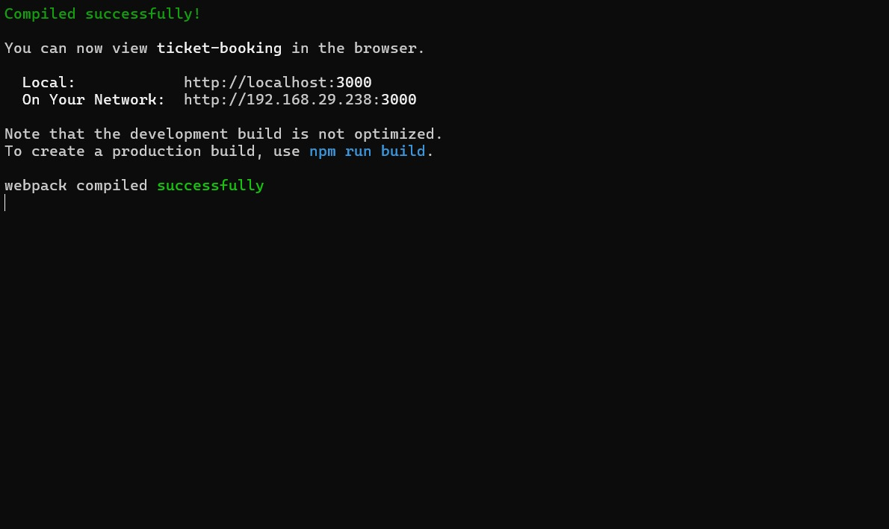
IMPLEMENTATION SCREENSHOTS
1
2
3
4
5
6
7
8
To implement the React JS based Ticket Booking Web Application, first install Node.js on your system, as it includes npm (Node Package Manager), which is required to manage dependencies. After installation, verify it by running node -v and npm -v in the Command Prompt.
Then navigate into the project folder using cd ticket-booking-app and start the application by running npm start, which will open the project in a browser at http://localhost:3000
9

Slide 11
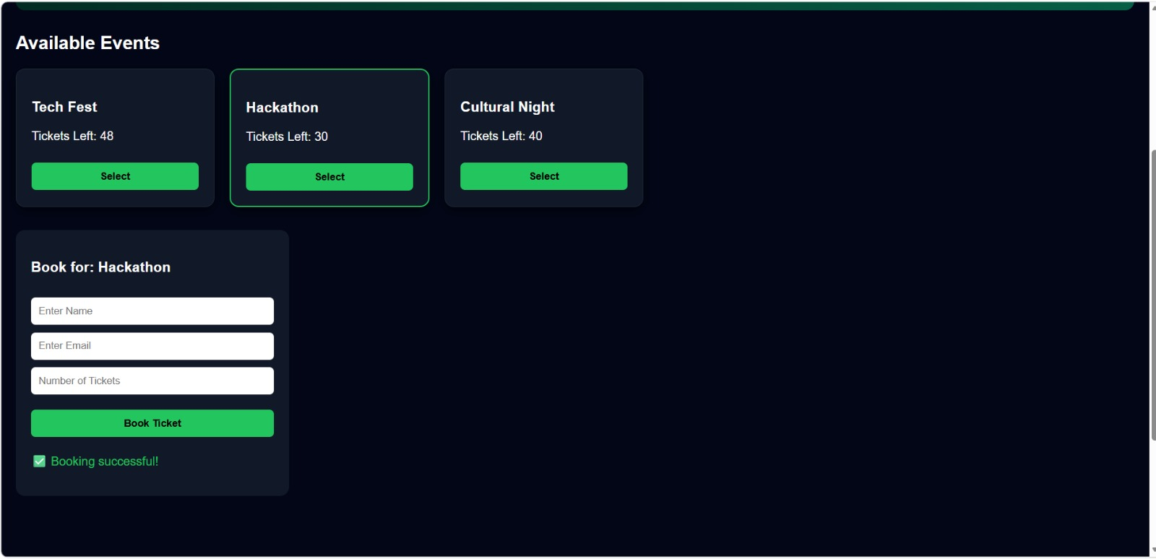
IMPLEMENTATION SCREENSHOTS
1
2
3
4
5
6
7
8(A)
The Event Ticket Booking system is implemented using a React JS interface where users can view available events such as technical fests and seminars with details like date, time, and seat availability.
The system processes the booking and displays a confirmation with booking details. All user, event, and booking data are stored and managed efficiently in the backend database.
9

Slide 12
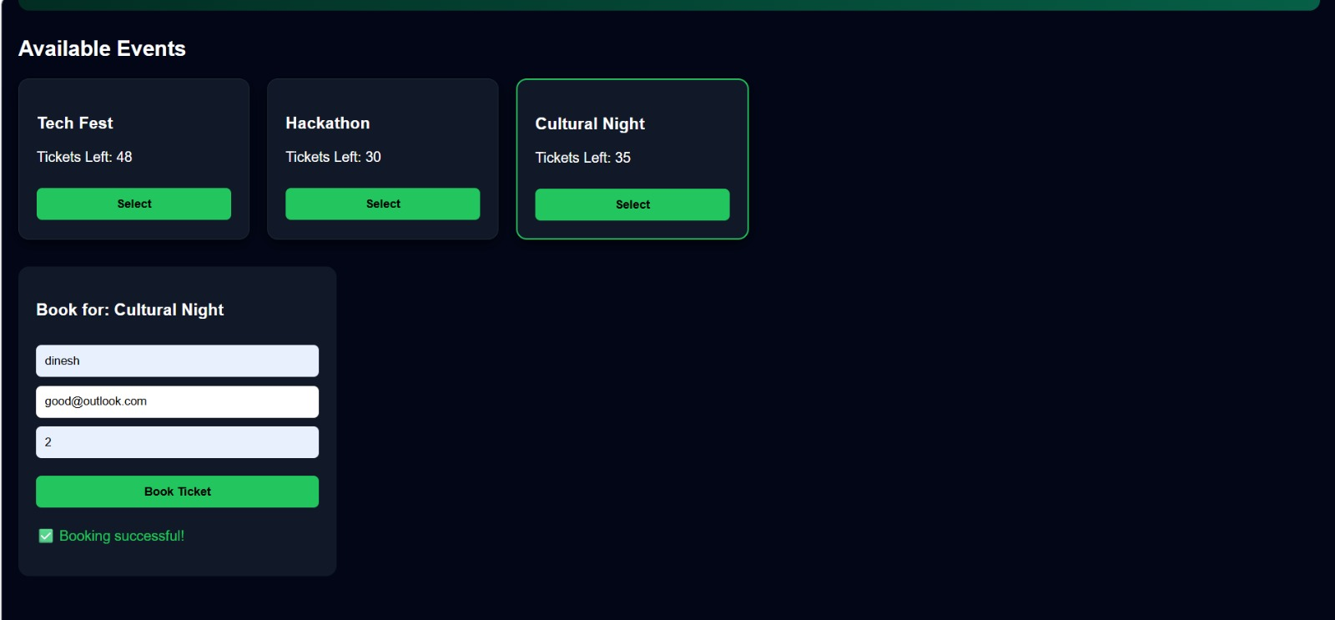
IMPLEMENTATION SCREENSHOTS
1
2
3
4
5
6
This status ensures the user receives the fastest possible assistance and the most comprehensive toolset available. After successful booking, a ticket summary is generated displaying all user and event details.
After successful booking, a ticket summary is generated displaying all user and event details.
7
8(B)
9

Slide 13
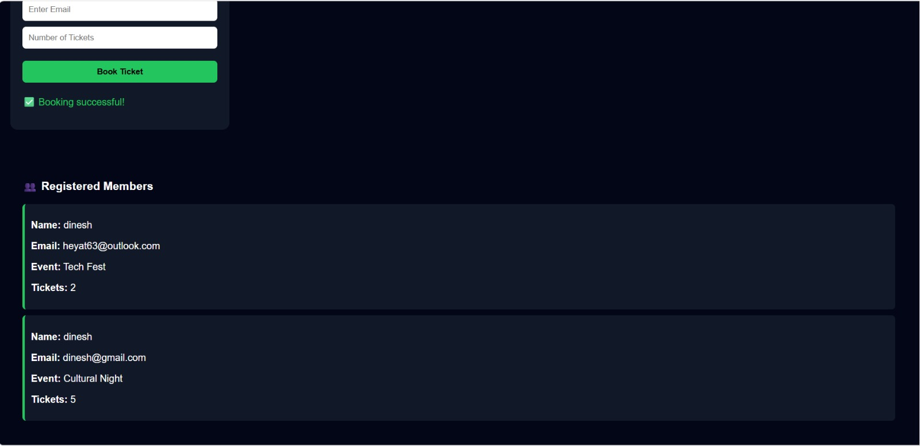
IMPLEMENTATION SCREENSHOTS
1
2
3
4
5
6
7
8(C)
This project demonstrates efficient use of React components and state management for building a dynamic web application.
After booking, a ticket summary page is displayed showing all relevant details such as name, event, number of tickets, and total amount.
9

Slide 14
ADVANTAGES & LIMITATIONS
1
ADVANTAGES :
The Event Ticket Booking System provides a simple and user-friendly interface that makes event registration easy for users.
It allows quick booking of tickets with automatic price calculation, reducing manual errors.
The application is fast and responsive since it is built using React JS with component-based architecture.
It improves efficiency by organizing event selection, booking, and confirmation in a single platform.
Limitations:
The system currently works only on the frontend and does not store data permanently, so bookings are lost after page refresh.
It does not include authentication or user login features, which limits personalized access.
There is no backend or database integration for managing large-scale event data. Payment processing is not implemented, so it is not suitable for real-world ticket transactions.
The system does not support seat selection or real-time availability checking, which is essential for large-scale ticket booking platforms.
2
3
4
5
6
7
8
9

Slide 15
Thank you

